Slide 1
Gama Correction Procedure
图形进入显卡
(Gama Coding)
Frag Shader
(Calculation)
图形进入显示器
(Gama Decoding)

Slide 2
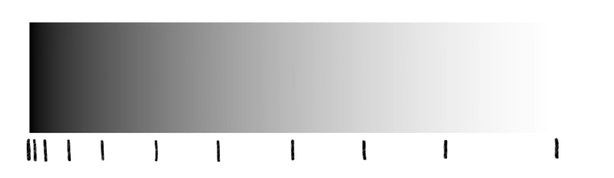
Brightness in reality
0.2
自然亮度采样
0.5
人眼(After Gama correction)亮度采样
Brightness in eye

Slide 3






Gama Correction -> Using Gama Brightness sampling and calculating
Gama
(0.2)
$$x^{1/2.2}$$
$$x^{2.2}$$
(0.5 * 2 * 0.4)
0.13
Linear
(0.2)
$${0.2}^{1/2.2}$$
$$x^{2.2}$$
$$x^{1/2.2}$$
$$x^{2.2}$$
0.5
0.2 * 5 * 0.4
0.65
0.38
Bright
Color

Slide 4
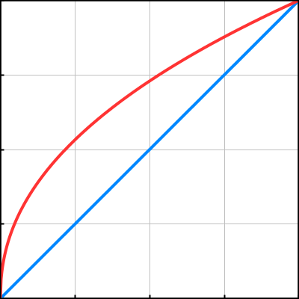
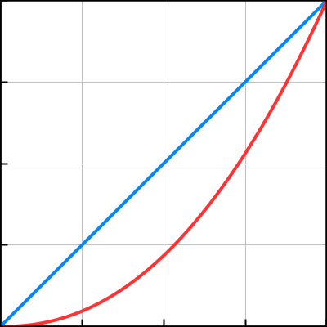
Gama Correction Coding VS Decoding
Gama Coding
Gama Decoding

Slide 5
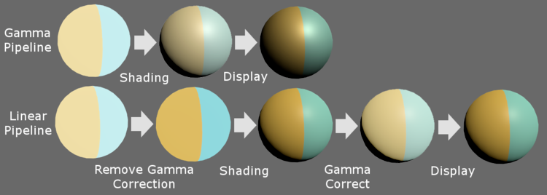
Conclusion :
Linear is more realistic and reasonable when dealing the light calculation
Gama correction is much more suitable for human’s eye
Linear is brighter than gama

